Slide 1



CASE STUDY
Developing a secure network protocol for IOT devices in smart homes
Presented by
Name: Registration No:
Kingshu Rakshit 2141018044
Swayam Pratik Das 2141004019
Dipyaman Sahu 2141019137
Debashish Maharana 2141013030

Slide 2


Table of Content
Introduction
Identify the Problem
Root Cause Analysis
Solution Development
Result
Implementation
Conclusion
References

Slide 3

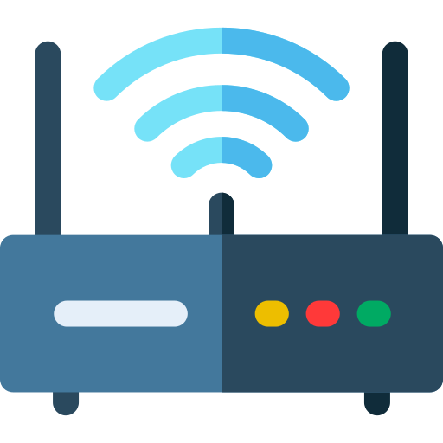
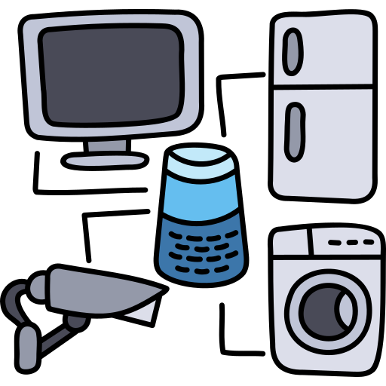


INTRODUCTION
A typical smart home architecture consists of four entities:
Registration authority (RA) : RA is a trusted entity that mainly authorizes the gateway as the home registration center.
Gateway : Gateway is a semi-trusted entity that helps users to communicate with smart home devices and is responsible for registration.
Smart devices (IoT devices) : Smart device refers to all kinds of smart home appliances in the family, such as smart refrigerators, smart air conditioners, etc., where they are semi-trusted entities, and are connected to the gateway by wireless networks to provide users with various services.
Users : Only family members can register with the gateway to become legal users.

Slide 4
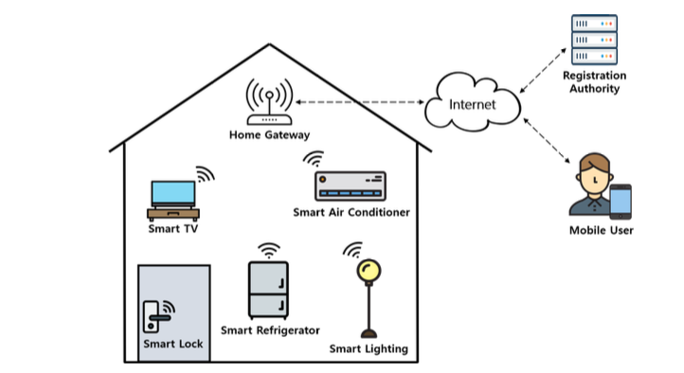
Fig 1. Smart Home
In this architecture, users need to connect the home devices via the gateway, and then operate the home devices through the smart home APP or voice assistant, such as adjusting the indoor temperature, switching lights, adjusting curtains, playing music, etc.
Although the smart home has changed people’s lives, it faces many security threats and challenges. For example, since smart home devices are connected to the Internet, malicious attackers can access users’ private information by intercepting transmitted messages via open channels. Therefore, ensuring a secure smart-home IoT access control scheme is very important.

Slide 5
Identify the Problem
New wave of security risks: The proliferation of IoT devices in smart homes introduces a new wave of security risks that threaten the integrity of home networks and the safety of their occupants.
Vulnerabilities due to design: Many IoT devices, such as smart thermostats, lights, and security cameras, are designed to be low-power and low-cost, but this often comes at the expense of robust security features.
"Domino effect" of interconnected devices: The interconnected nature of IoT devices in smart homes creates a "domino effect" where a single compromised device can be used as an entry point to attack other devices on the network.
Frequent vulnerabilities to hacking and exploitation: As a result, these devices are frequently vulnerable to hacking and exploitation, allowing malicious actors to:
• Gain unauthorized access to sensitive information
• Disrupt home systems
• Compromise physical safety

Slide 6
Root Cause Analysis
Lack of standardized security protocols and regulations: IoT device manufacturers are not held to a common set of security standards, leading to a proliferation of devices with inadequate security features.
Design prioritizing convenience over security: Many IoT devices are designed with ease of use in mind, rather than security, resulting in devices with default passwords, open ports, and other vulnerabilities.
Outdated and legacy operating systems: The use of outdated and legacy operating systems on IoT devices makes them more vulnerable to attacks.
Limited resources and capabilities of IoT devices: The limited processing power, memory, and storage capacity of many IoT devices make it challenging to implement robust security measures.
Lack of awareness and education among consumers: Consumers are often unaware of the security risks associated with IoT devices and do not follow proper security practices, exacerbating the problem.

Slide 7
Solution Development
The proposed system is composed of a mobile user (MU), a smart device (SD), a home gateway (HGW), and a Registration authority (RA).
RA and HGW are trusted entities in smart home environments.
RA is responsible for initializing the system and registering MU and SD. MU first needs to register at RA to utilize services.
SD and HGW also need to register at RA for providing home services. After receiving the registration request message from MU and SD, RA stores the information of each entity in the mobile device of MU and in the memory of SD.
RA also stores all information required for the authentication of the MU and SD in HGW’s database. Then, the MU and SD perform the mutual authentication and session key (Flag) agreement with the help of the HGW. With this session key, MU and SD can utilize secure smart home services.

Slide 8
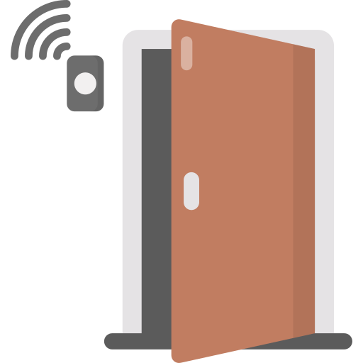
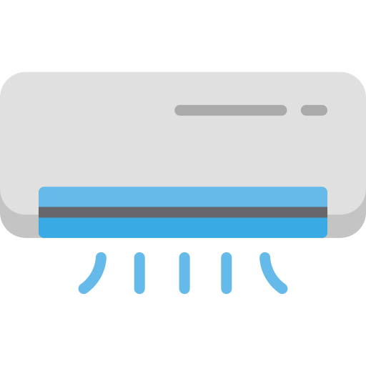

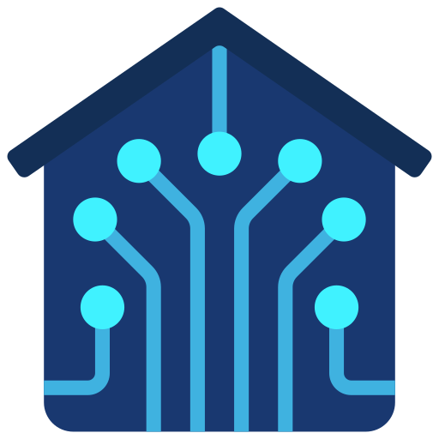

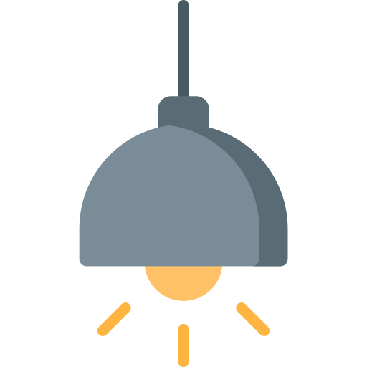





Protocol (1)
Gateway (HGW)
Registration Authority (RA)
Protocol (3)
Protocol (2)
Smart devices (SD)
Mobile Users (MU)
Fig 2. Network Model of Smart Home

Slide 9
Result
device ID (ID_sd) Master Key (MK_ra)
Secret key (SK_sd) X_sd-ra = h(PID_sd || MK_ra)
Computes: PID_sd-ra = h(PID_sd -xor- X_sd-ra)
PID_sd = h(ID_sd || SK_sd) [ X_sd-ra, PID_ds-ra, ID_sd : stores
in the database of HGW ]
A1 = h(SK_sd -xor- X_sd-ra)
A2 = h(ID_sd -xor- PID_sd-ra)
[ A1, A2: stores in the smart device (SD) ]
Protocol (1) : Smart device registration phase of the proposed protocol.
Smart device (SD)
Registration Authority
PID_sd, ID_sd
X_sd-ra,
PID_sd-ra

Slide 10
Username (U_mu) Master Key (MK_ra)
Password (Pwd_mu) X_mu-ra = h(PID_mu||MK_ra)
Biometrics (Bio_mu) PID_mu-ra = h(PID_mu -xor-X_mu-ra)
Compute: [ X_mu-ra, PID_mu-ra: stores in
PID_mu = h(U_mu||P_mu||B_mu) HGW’s database]
B1 = h(PID_mu -xor- X_mu-ra)
B2 = h(PID_mu -xor- PID_mu-ra)
[ B1, B2: stores in Mobile user’s
database ]
Protocol (2) : Mobile user registration phase of the proposed protocol.
Mobile User (MU)
Registration Authority (RA)
PID_mu
X_mu-ra,
PID_mu-ra

Slide 11
I/P :
U_mu,
Pwd_mu,
B_mu
Compute:
PID_mu =
h(U_mu||Pwd_mu||B_mu)
Compute:
*PID_mu-ra = PID_mu-xor-X_mu-ra
if *PID_mu-ra == D(PID_mu-ra):
*A1 = SK_sd -xor- X_sd-ra
if *A1 == D(A1):
Compute:
Session key (Flag)
Flag = False —> True
*PID_sd-ra = D(A2) -xor-ID_sd
if *PID_sd-ra == D(PID_sd-ra):
Protocol (3) : Authentication and key agreement phase.
MU
Stores:
B1, B2
HGW
Stores:
PID_mu-ra, X_mu-ra,
PID_sd-ra, X_sd-ra, ID_sd
SD
Stores:
A1, A2
PID_mu
X_sd-ra
A2, Flag

Slide 12
HGW
Stores:
PID_mu-ra, X_mu-ra,
PID_sd-ra, X_sd-ra, ID_sd
*PID_sd-ra = D(A2) -xor-ID_sd
if *PID_sd-ra == D(PID_sd-ra):
*B1 = PID_mu -xor- X_mu-ra
*B2 = PID_mu -xor- PID_mu-ra
if *B1 == D(B1) and *B2 == D(B2) and Flag==True:
(MU) …. Paired …. (SD)
MU
Stores:
B1, B2
SD
Stores:
A1, A2
Flag, PID_mu-ra, X-mu-ra

Slide 13

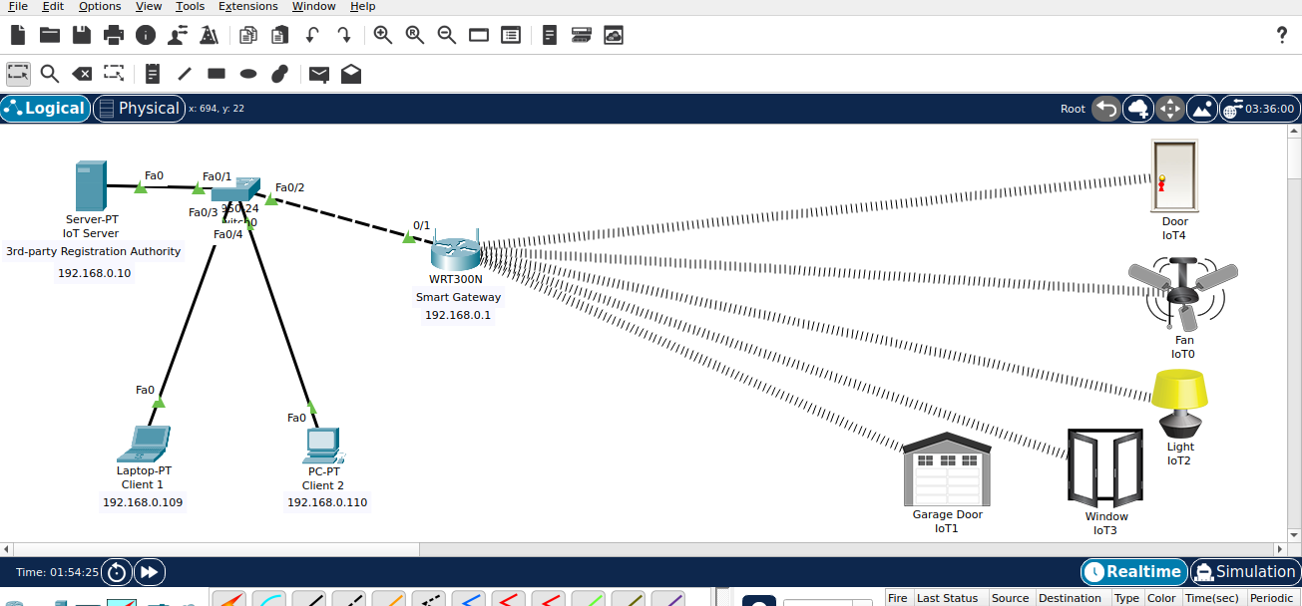
Implementation
Fig 3. Network Model of Smart Home

Slide 14
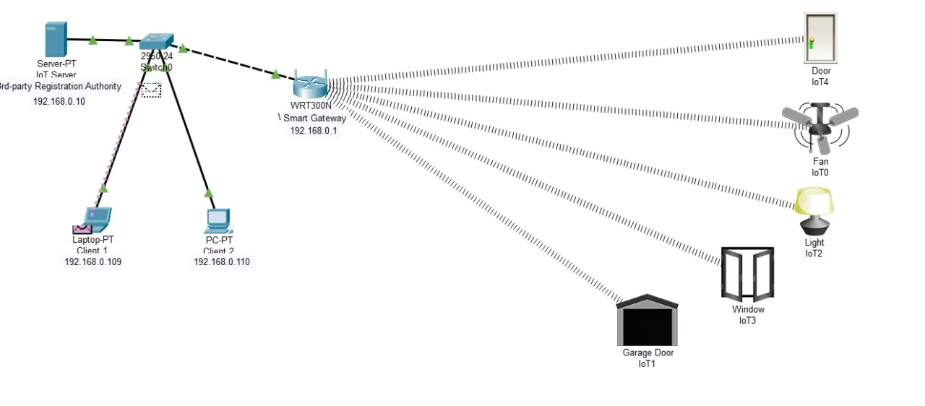
Vid.1 - Registration between (MU) & (RA)

Slide 15
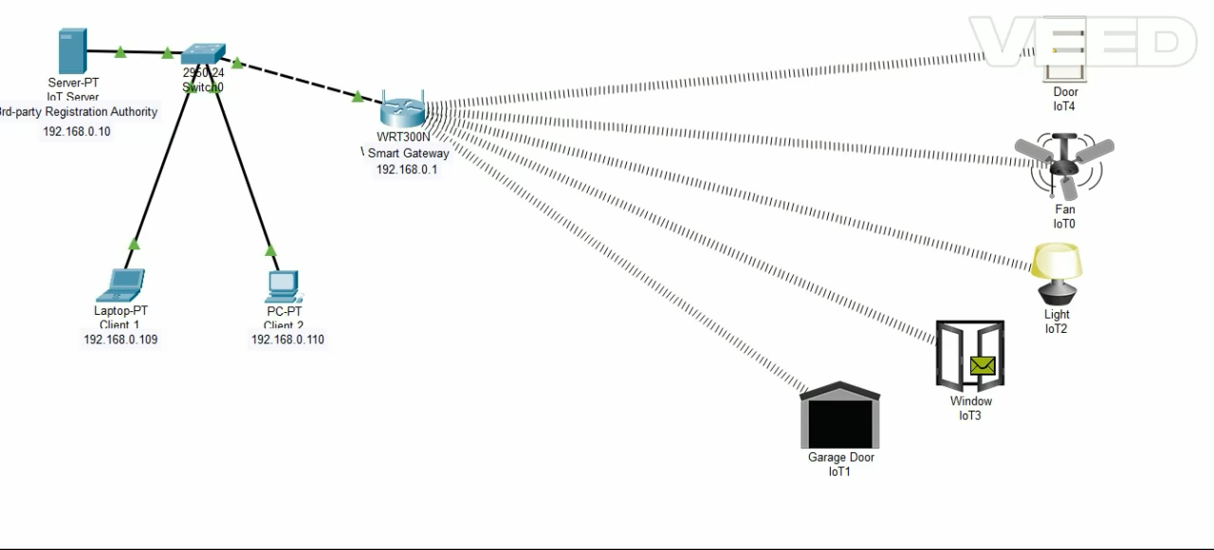
Vid.2 - Registration between (SD) & (RA)

Slide 16
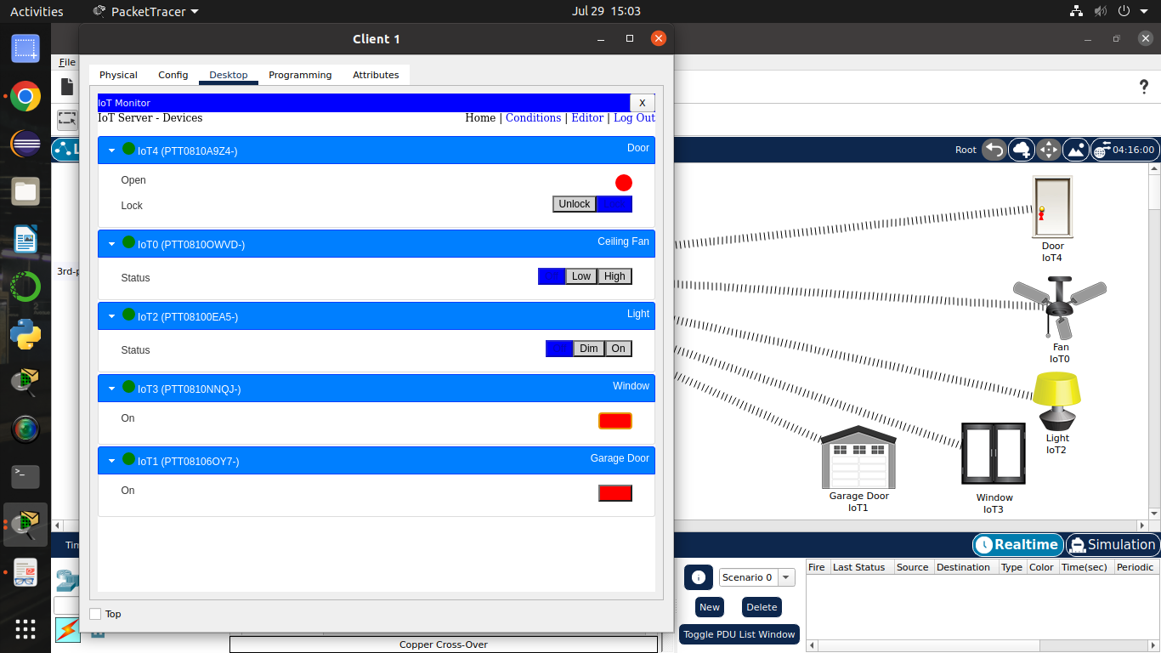
Fig 4. Panel where the user can manage the IoT devices connected with your Smart Home

Slide 17
Conclusion
The integration of IoT devices in smart homes has undoubtedly brought about numerous conveniences and improvements to our daily lives.
However, it has also introduced a plethora of security risks that cannot be ignored. The vulnerabilities of IoT devices, combined with the interconnected nature of smart home systems, create a perfect storm of potential security breaches.
It is imperative that manufacturers, policymakers, and consumers alike take proactive steps to address these risks and develop robust security protocols to protect the integrity of home networks and the safety of their occupants.
By doing so, we can ensure that the benefits of IoT technology are realized without compromising our privacy, security, and well-being. The future of smart homes depends on it.

Slide 18
References
Towards a Secure Smart-Home IoT Access Control Scheme Based on Home Registration Approach. Authors: Tsu-Yang Wu, Qian Meng, Yeh-Cheng Chen, Saru Kumari and Chien-Ming Chen Publication: MDPI (Academic Open Access Publishing) | https://www.mdpi.com/2227-7390/11/9/2123
Smart Assistive Architecture for the Integration of IoT Devices, Robotic Systems, and Multimodal Interfaces in Healthcare Environments Authors: Alberto Brunete, Ernesto Gambao, Miguel Hernando and Raquel Cedazo Publication: MDPI (Academic Open Access Publishing) | https://www.mdpi.com/1424-8220/21/6/2212

Slide 19

Thank you

